Slide 1

Mihotel

Slide 2
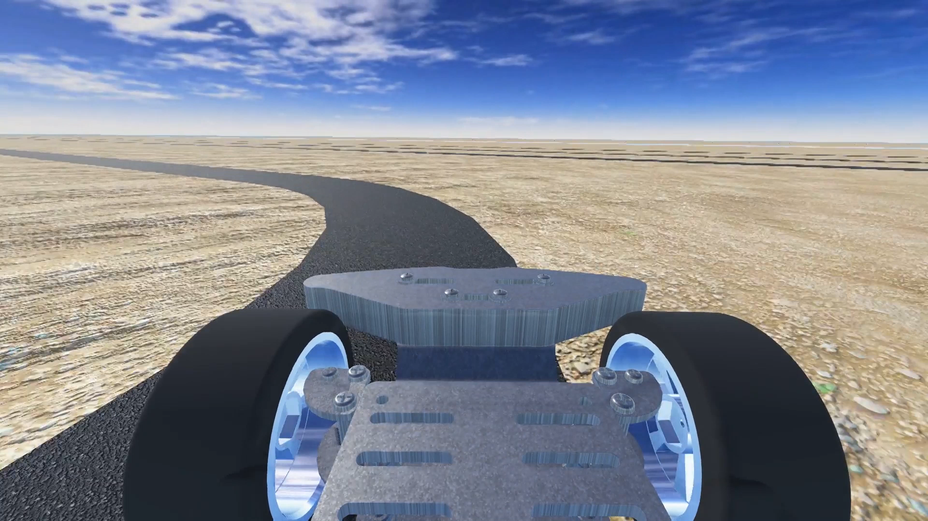
Team Project Presentation
Team Design Project and Skills
2020.06

Slide 3

CONTENTS
PART ONE
PART TWO
PART THREE
Preliminary
Design
Conclusion
Division of Work
Management
Environment
System
Decision
Visual
Chassis
Development Strategy

Slide 4
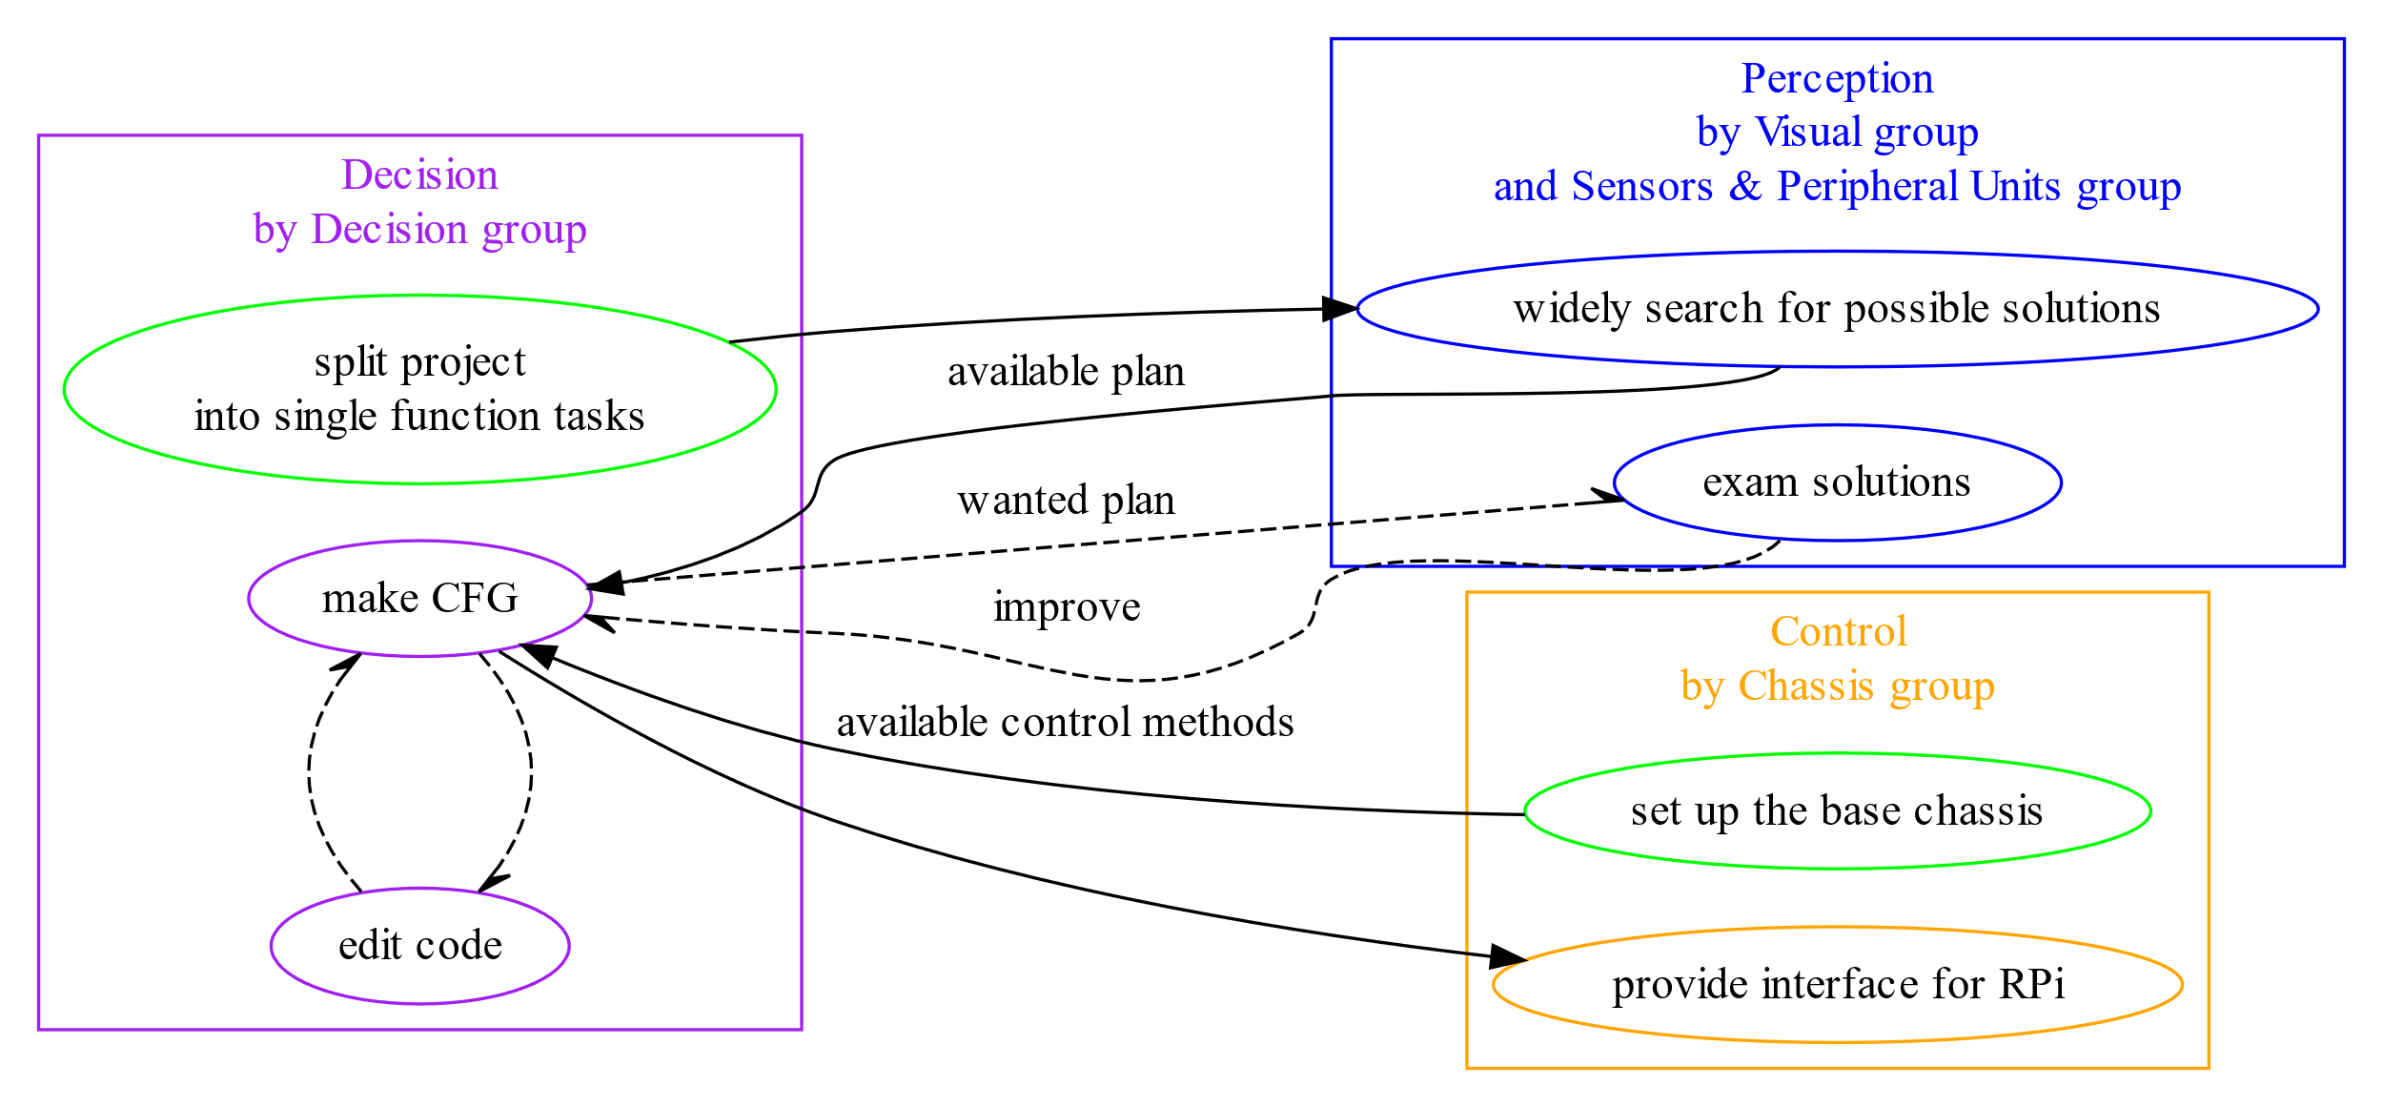
Preliminary
Division of Work
Management
Design
Environment
System
Decision
Visual
Chassis
Conclusion
Notes:
需要一个项目总体的图

Slide 5
PART ONE
PART TWO
PART THREE
Preliminary
Division of Work
Management
Design
Design
Conclusion
Environment
System
Decision
Visual
Chassis
Division of Work
Management
Detail Design of Subgroups
What We learnt from the Project
Development Strategy
Conclusion
Notes:
需要一个项目总体的图

Slide 6
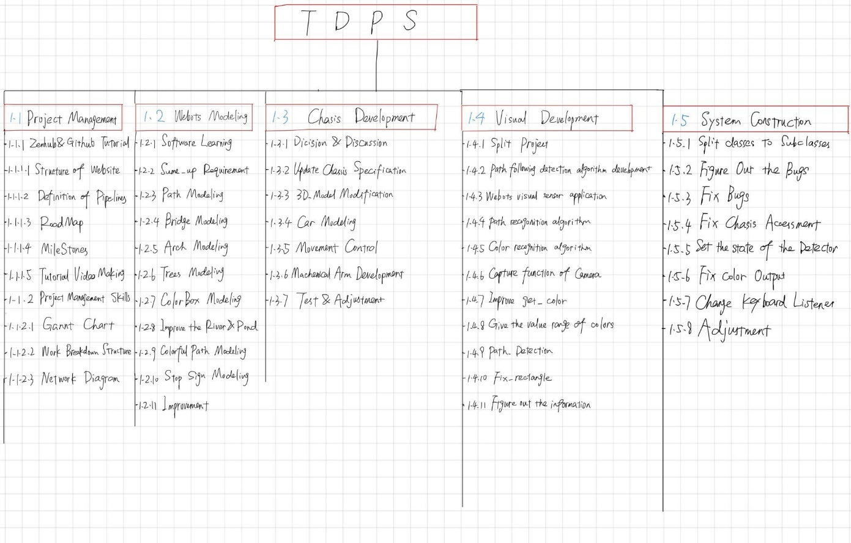
Preliminary
Division of Work
Management
Design
Environment
System
Decision
Visual
Chassis
Conclusion
Development Strategy
Work Breakdown Structure
Notes:
需要一个项目总体的图

Slide 7





Development Strategy
Preliminary
Division of Work
Management
Design
Environment
System
Decision
Visual
Chassis
Conclusion
Work Breakdown Structure
Visual Group
Decision Group
Chassis Group
Environment Group
System Group
Chang Shu
Bo Wen
Haoran Han
Jinwei Chu
Huiyu Xiong
Haotian Wang
Chaofan Shi
Zijian Wang
Hanpeng Xu
Zhuheng Song
JinWei Chu 2357643C
Huiyu Xiong 2357680X
ZhuHeng Song 2357651S
Zijian Wang 2357660W
HanPeng Xu 2357916X
Chang Shu 2357702S
Bo Wen 2357658W
HaoRan Han 2357662H
HaoTian Wang 2357667W
ChaoFan Shi 2357686S
Notes:
需要一个项目总体的图

Slide 8

Work Breakdown Structure
Preliminary
Environment Group
System Group
Decision Group
Visual Group
Chassis Group
Division of Work
Management
Jinwei Chu
Huiyu Xiong
Zhuheng Song
Zijian Wang
Hanpeng Xu
Chang Shu
Bo Wen
Haoran Han
Haotian Wang
Chaofan Shi
Design
Environment
System
Decision
Visual
Chassis
JinWei Chu 2357643C
Huiyu Xiong 2357680X
ZhuHeng Song 2357651S
Zijian Wang 2357660W
HanPeng Xu 2357916X
Chang Shu 2357702S
Bo Wen 2357658W
HaoRan Han 2357662H
HaoTian Wang 2357667W
ChaoFan Shi 2357686S
Conclusion

Slide 9
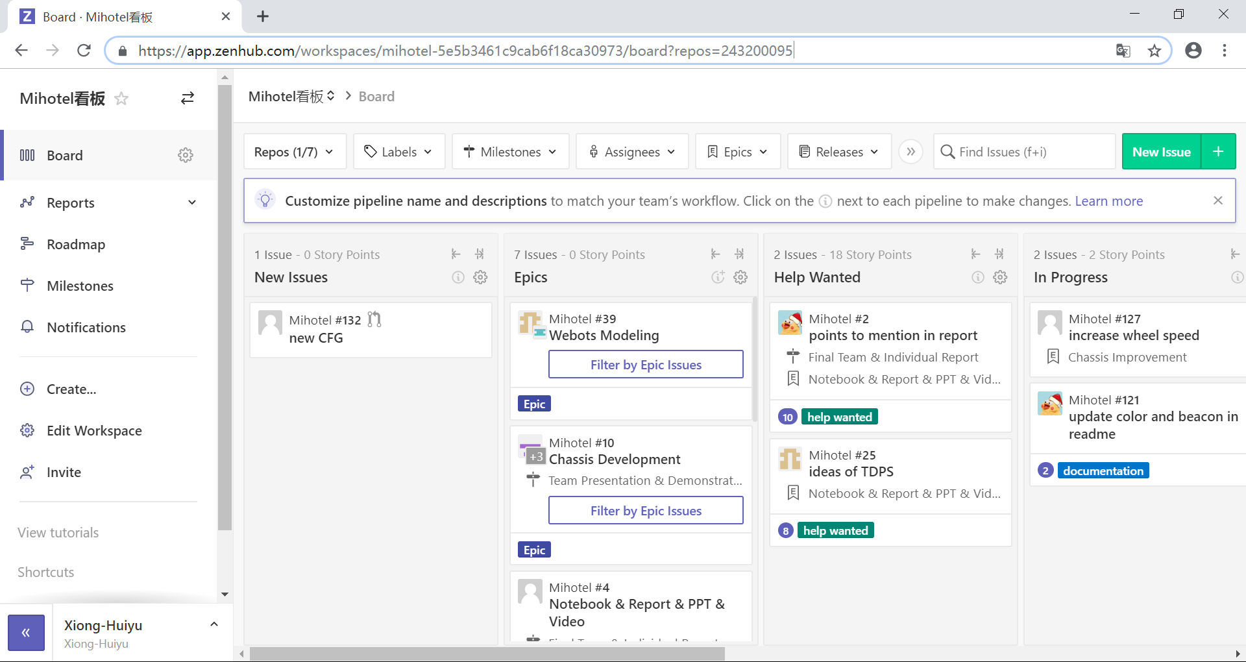

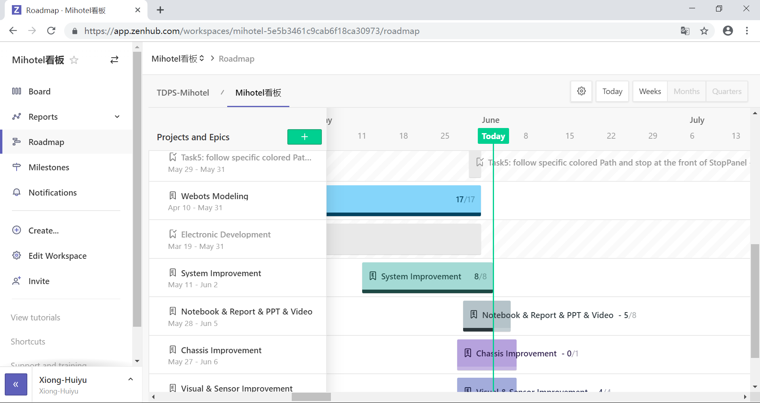
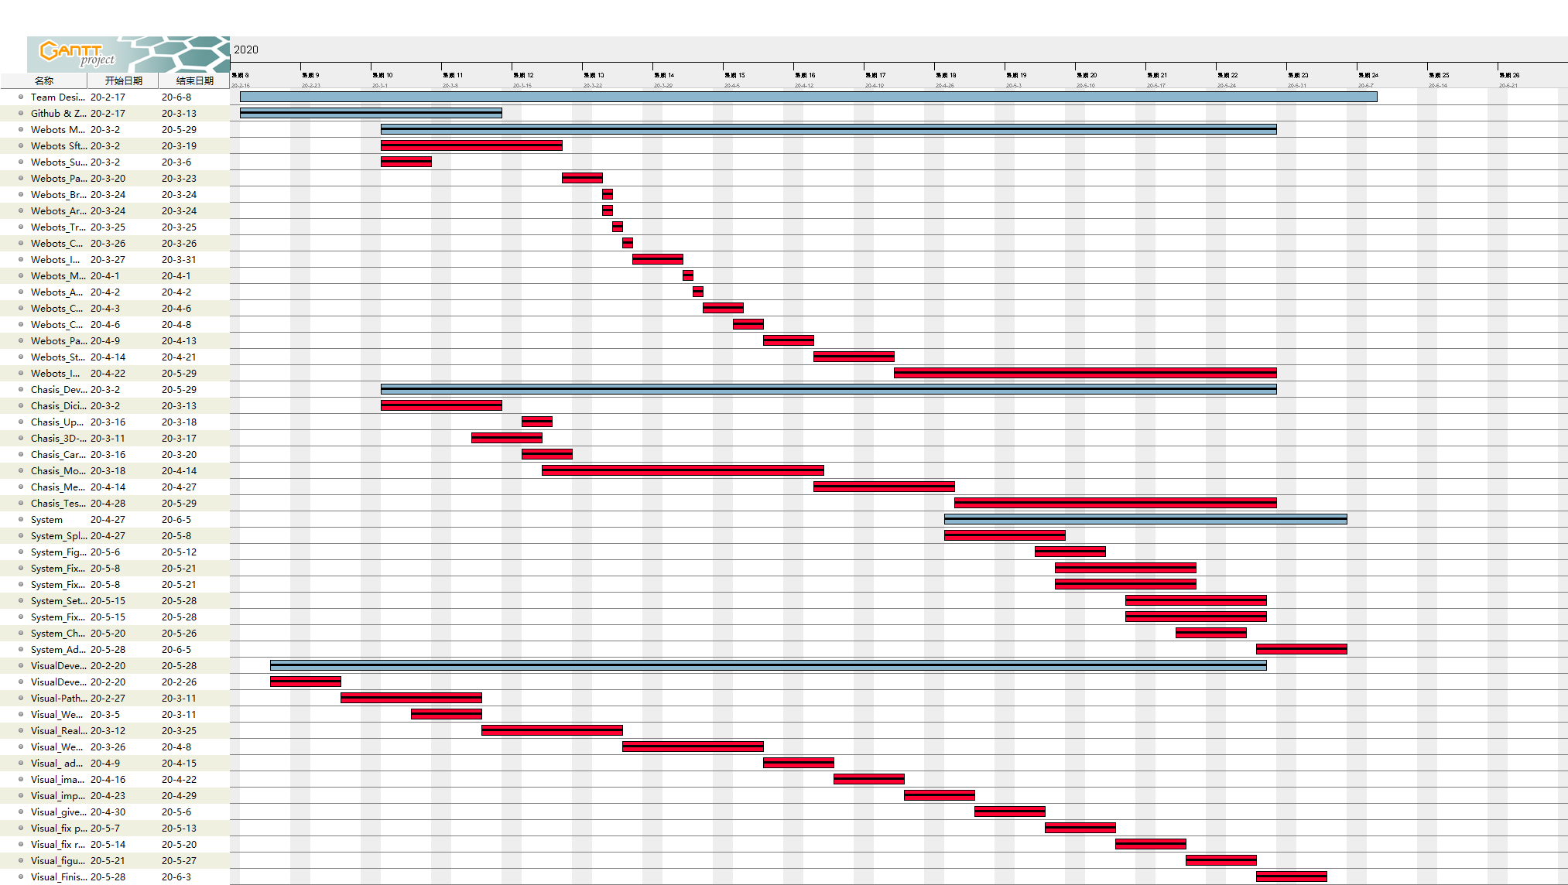
Environment Group
System Group
Decision Group
Visual Group
Chassis Group
Jinwei Chu
Huiyu Xiong
Zhuheng Song
Zijian Wang
Hanpeng Xu
Chang Shu
Bo Wen
Haoran Han
Haotian Wang
Chaofan Shi
JinWei Chu 2357643C
Huiyu Xiong 2357680X
ZhuHeng Song 2357651S
Zijian Wang 2357660W
HanPeng Xu 2357916X
Chang Shu 2357702S
Bo Wen 2357658W
HaoRan Han 2357662H
HaoTian Wang 2357667W
ChaoFan Shi 2357686S
Preliminary
Division of Work
Management
· Tutorial
· Specific Use
· Dashboard
· Roadmap
Design
Environment
System
Decision
Visual
Chassis
Conclusion
Notes:
此页图片缺

Slide 10
· Tutorial
· Specific Use
· Dashboard
· Roadmap
More Assessments
Preliminary
Division of Work
Management
· Self made Gantt chart
· Network Diagram
· SoW
· WBS
Design
Environment
System
Decision
Visual
Chassis
Conclusion
TASK FLOW

Slide 11
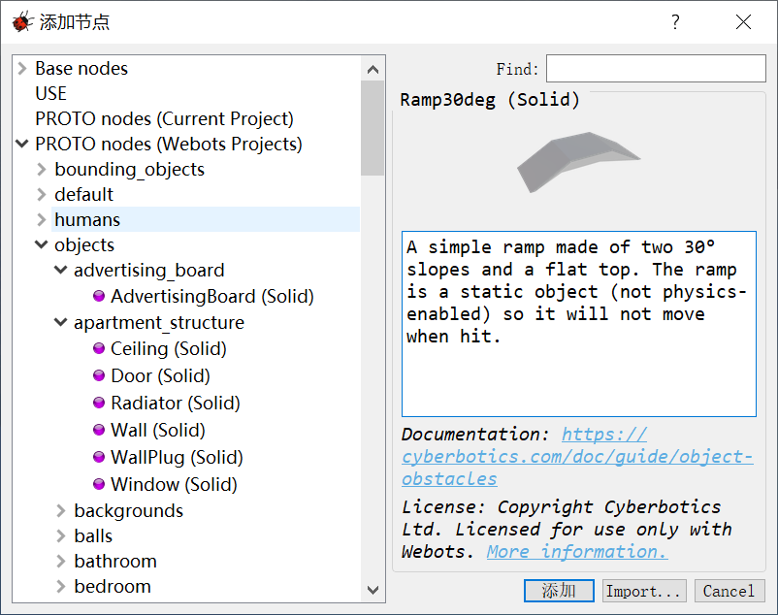
TASK FLOW
PART 01 TUTORIAL - LEARNING
Preliminary
Division of Work
Management
PART 02 TASK - RECOGNITION
Design
PART 03 COMPONENTS - RECOGNITION
Environment
System
Decision
Visual
Chassis
PART 04 CHOOSE OF SUBSTITUTION
PART 05 POSITION - ORGNIZATION
Conclusion
PART 06 FINAL ADJUSTMENT

Slide 12
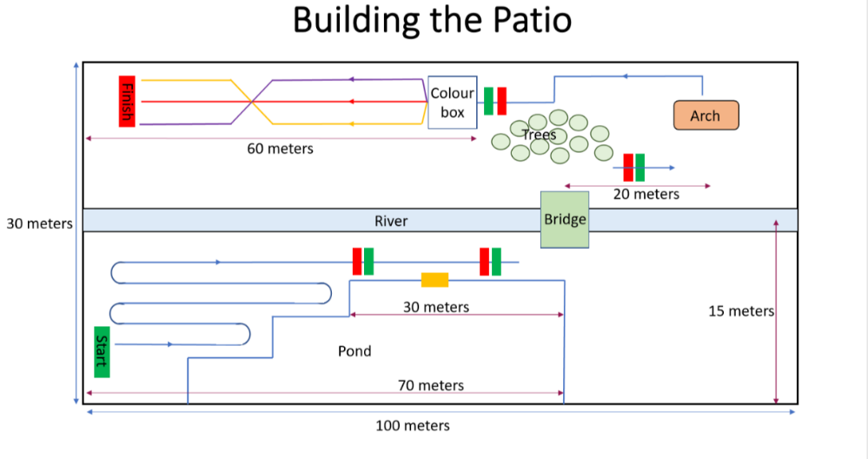
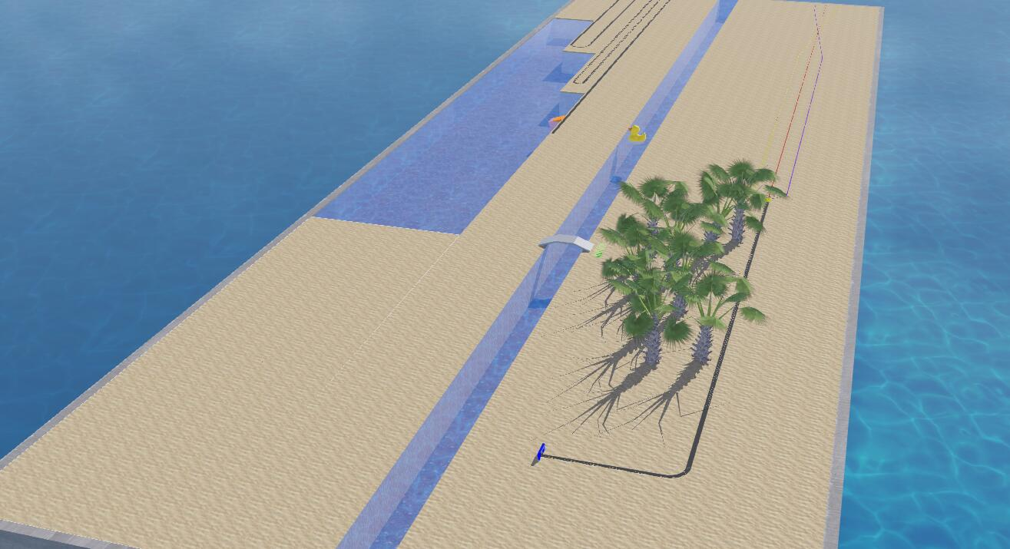
TASK FLOW
PART 01 TUTORIAL - LEARNING
Preliminary
Division of Work
Management
PART 02 TASK - RECOGNITION
Design
PART 03 COMPONENTS - RECOGNITION
Environment
System
Decision
Visual
Chassis
PART 04 CHOOSE OF SUBSTITUTION
PART 05 POSITION - ORGNIZATION
Conclusion
PART 06 FINAL ADJUSTMENT

Slide 13

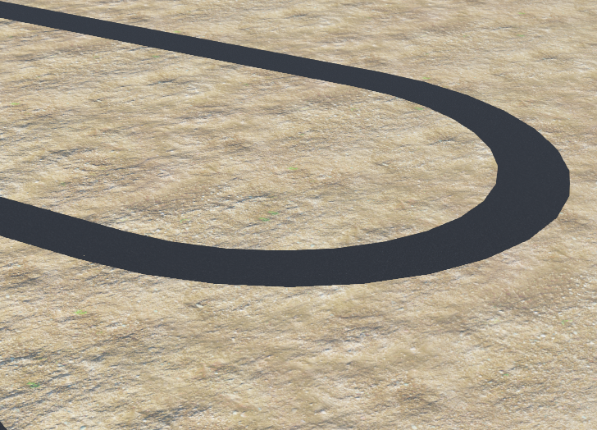
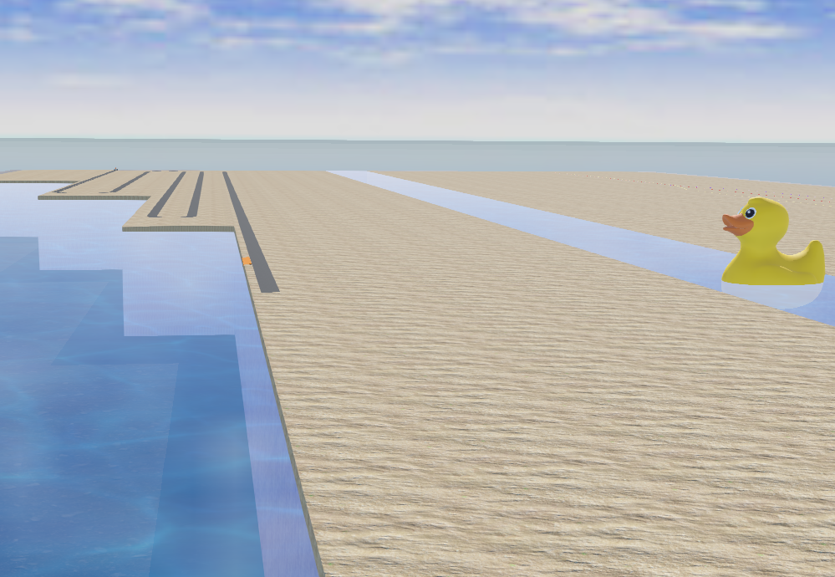
TASK FLOW
PART 01 TUTORIAL - LEARNING
Preliminary
Division of Work
Management
PART 02 TASK - RECOGNITION
Design
PART 03 COMPONENTS - RECOGNITION
Environment
System
Decision
Visual
Chassis
PART 04 CHOOSE OF SUBSTITUTION
PART 05 POSITION - ORGNIZATION
Conclusion
PART 06 FINAL ADJUSTMENT
PATROL
WATER
Curved Road Segment + Straight Road Segment
Pond Fluid + River Fluid

Slide 14

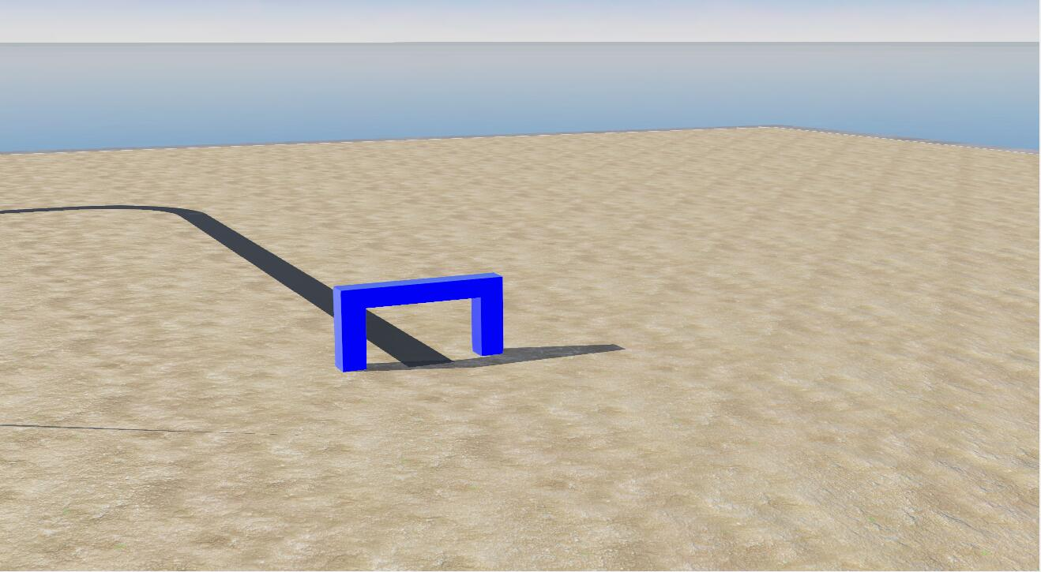
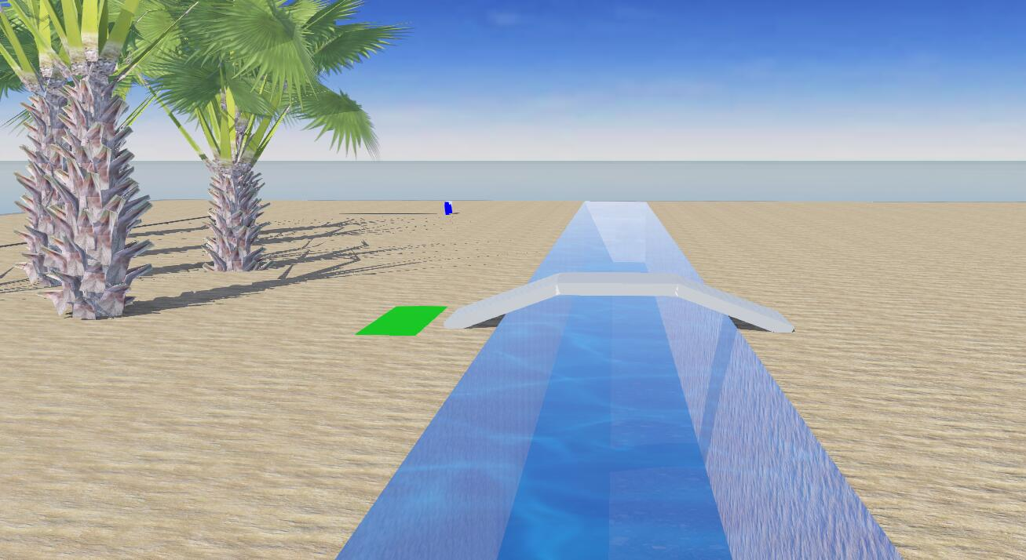
TASK FLOW
PART 01 TUTORIAL - LEARNING
PART 02 TASK - RECOGNITION
PART 03 COMPONENTS - RECOGNITION
PART 04 CHOOSE OF SUBSTITUTION
PART 05 POSITION - ORGNIZATION
PART 06 FINAL ADJUSTMENT
Preliminary
Division of Work
Management
Design
Environment
System
Decision
Visual
Chassis
Conclusion
PATROL
WATER
Curved Road Segment + Straight Road Segment
Pond Fluid + River Fluid
ARCH
BRIDGE
Left Solid + Right Solid + Up Solid
Bridge

Slide 15
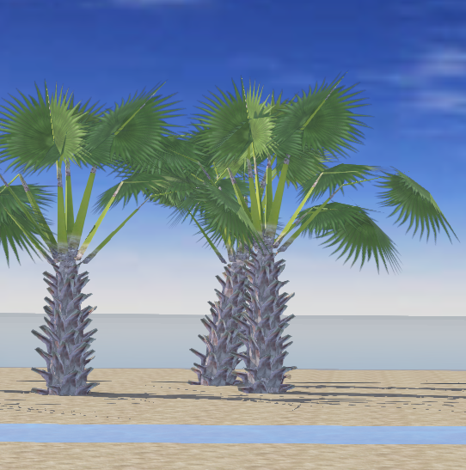
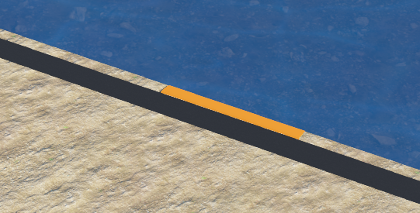
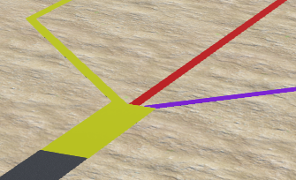
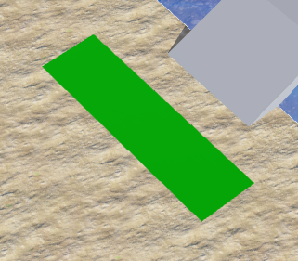
PATROL
WATER
Curved Road Segment + Straight Road Segment
Pond Fluid + River Fluid
Preliminary
Division of Work
Management
Design
Environment
System
Decision
Visual
Chassis
Conclusion
ARCH
BRIDGE
Left Solid + Right Solid + Up Solid
Bridge
TREES
BEACON
Palm Tree
Color Box

Slide 16
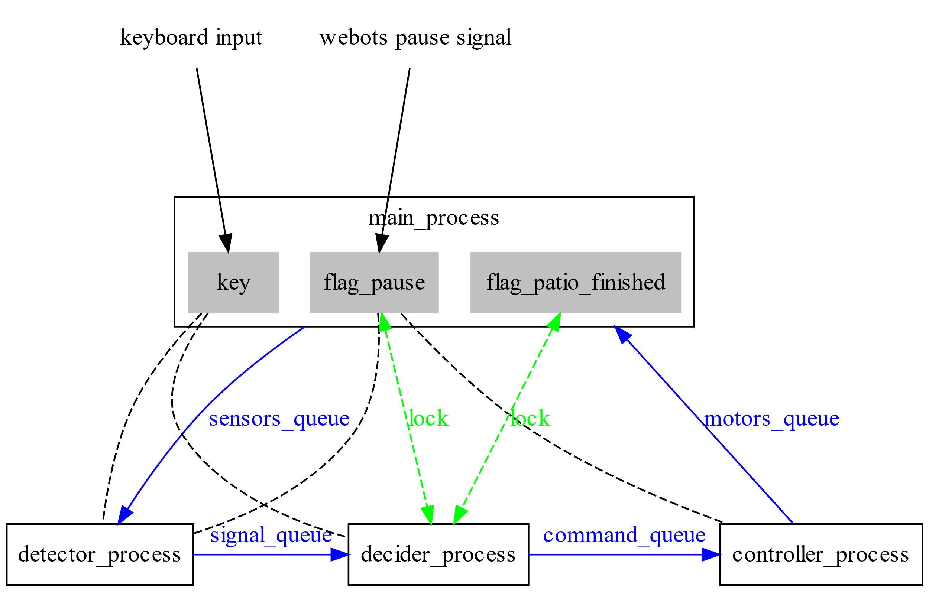
ARCH
BRIDGE
Left Solid + Right Solid + Up Solid
Bridge
Preliminary
Division of Work
Management
Design
Environment
System
Decision
Visual
Chassis
Conclusion
TREES
BEACON
Palm Tree
Color Box

Slide 17
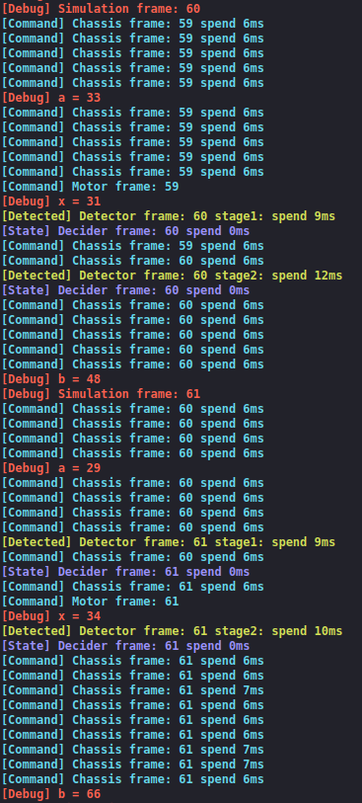
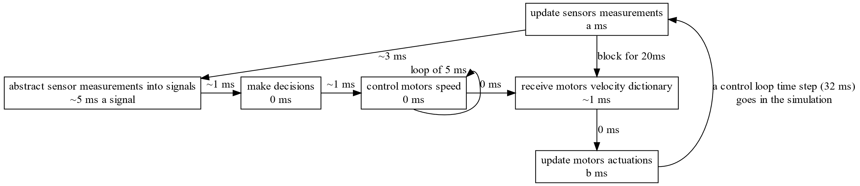
TREES
BEACON
Palm Tree
Color Box
Multiprocessing
Features
· 3 separate processes
· High performance
· easy to cooperate
Preliminary
Division of Work
Management
Design
Environment
System
Decision
Visual
Chassis
Conclusion

Slide 18
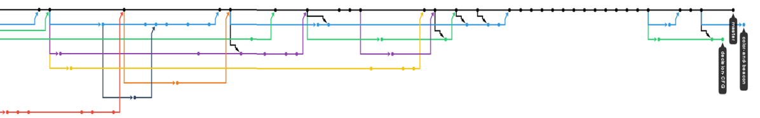
Multiprocessing
Features
· 3 separate processes
· High performance
· easy to cooperate
Preliminary
Division of Work
Management
Design
Environment
System
Decision
Visual
Chassis
Problems
· Data delay
· Frame loss
· blocking
Conclusion
git branch graph

Slide 19

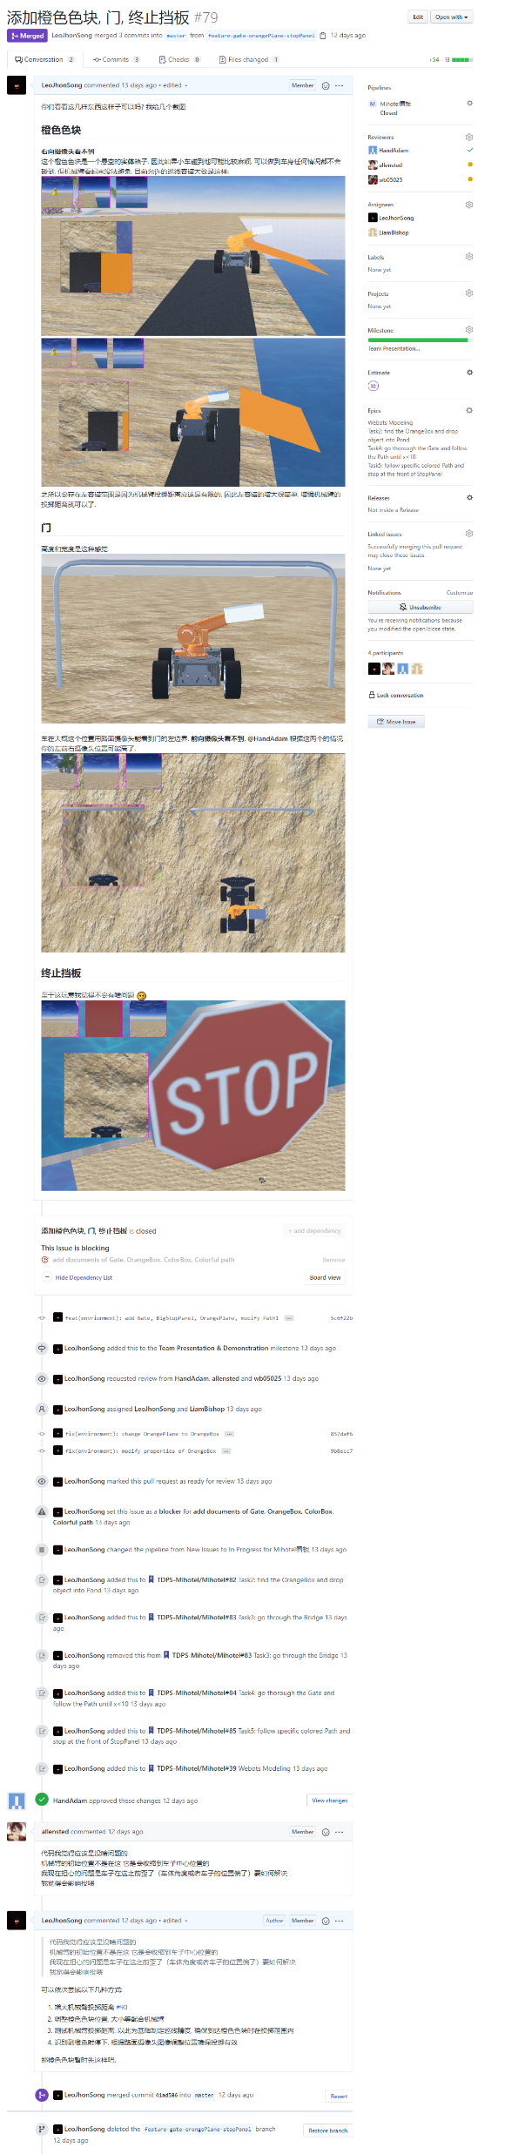
Multiprocessing
Features
· 3 separate processes
· High performance
· easy to cooperate
Problems
· Data delay
· Frame loss
· blocking
Version Control
Preliminary
Division of Work
Management
Design
Environment
System
Decision
Visual
Chassis
git branch graph
Conclusion
pull request

Slide 20
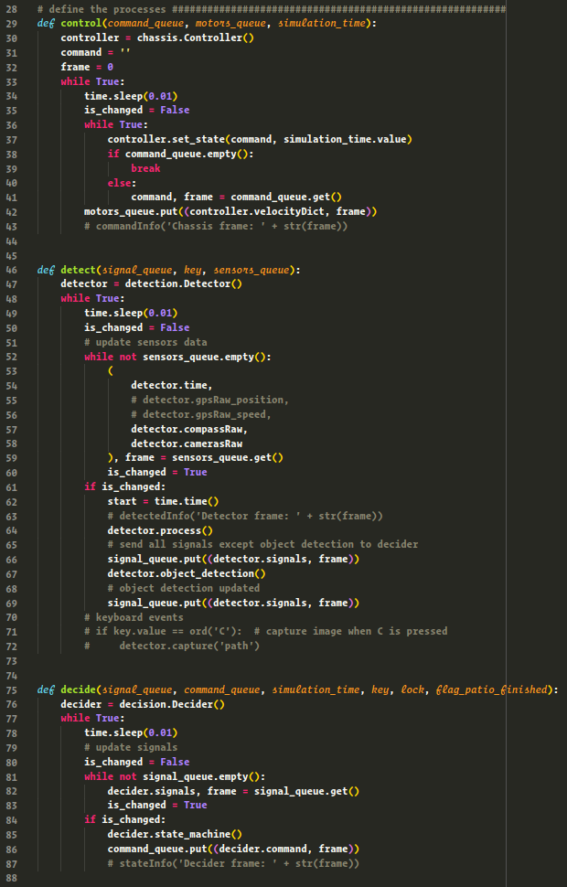
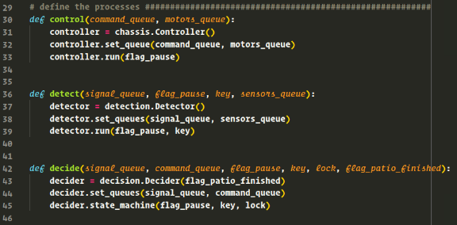

git branch graph
Version Control
Preliminary
Division of Work
Management
Design
Environment
System
Decision
Visual
Chassis
Conclusion
pull request

Slide 21
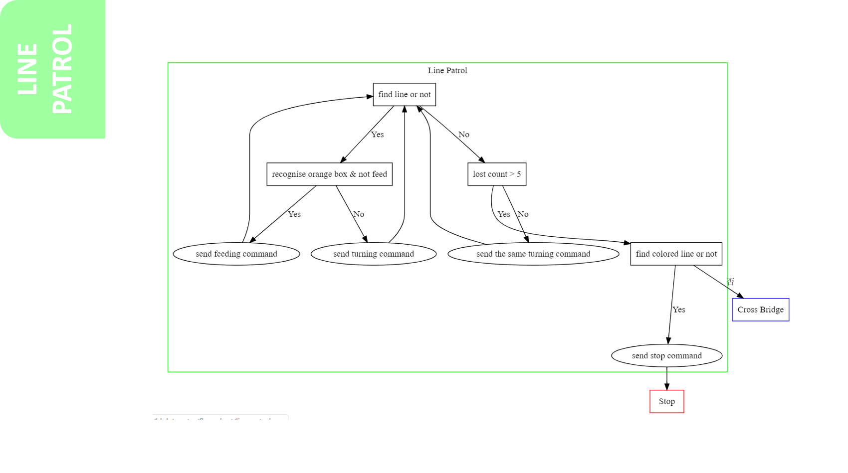
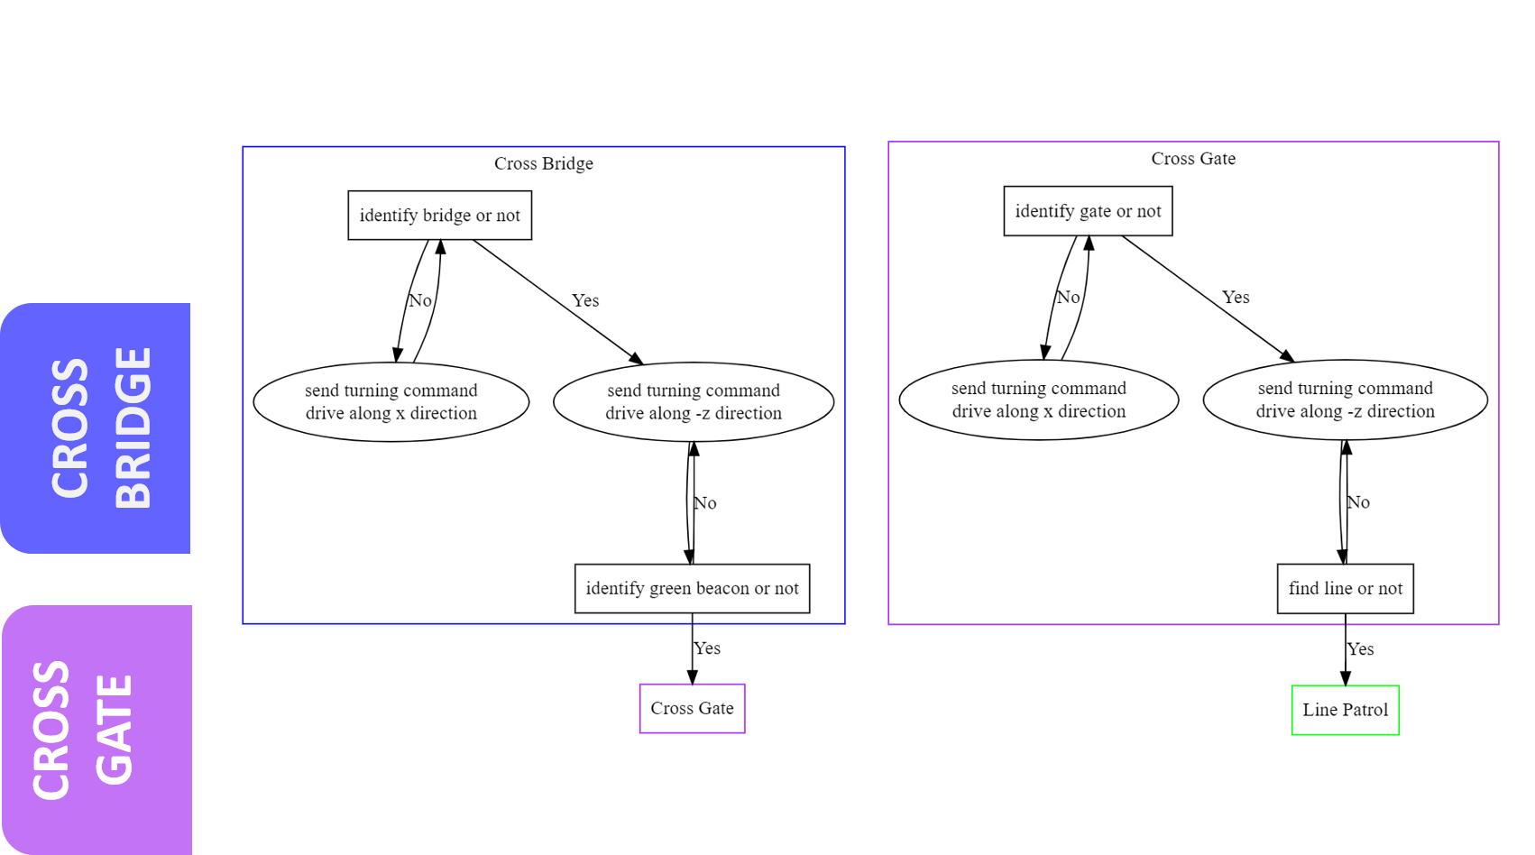
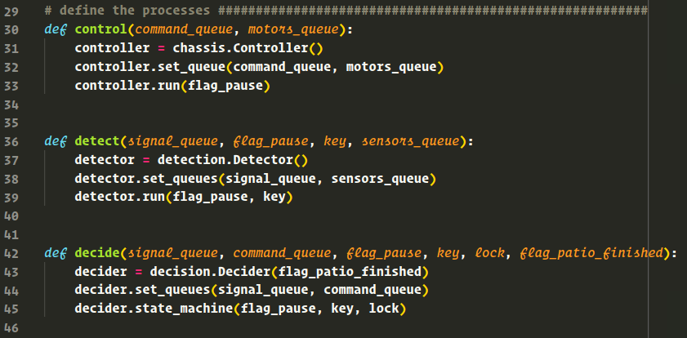
Version Control
pull request
Refactor & Optimize
Preliminary
Division of Work
Management
Design
Environment
System
Decision
Visual
Chassis
Conclusion
TOTAL DECISION DESIGN

Slide 22
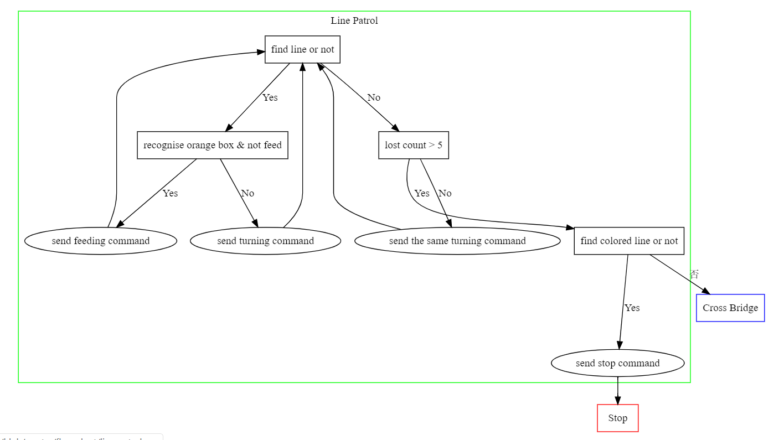
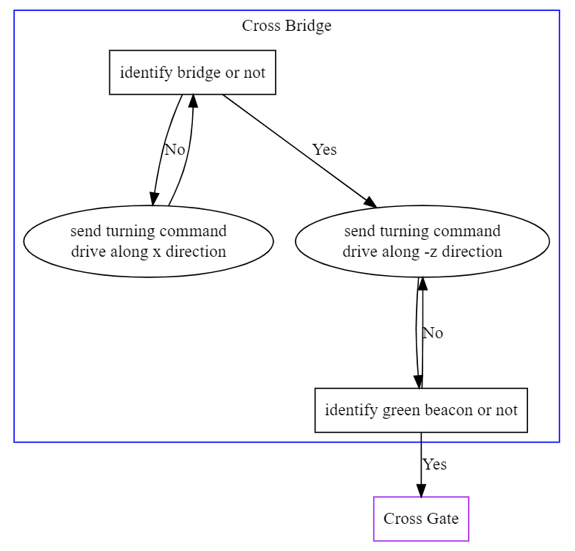
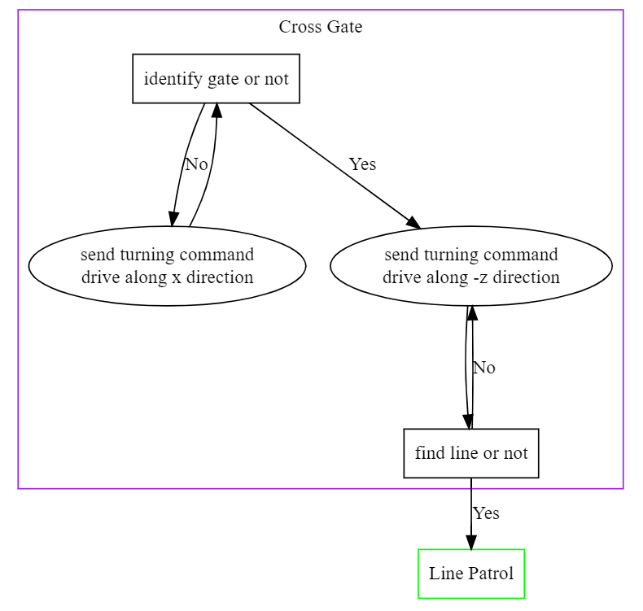
LINE PATROL
CROSS BRIDGE
CROSS GATE

Slide 23
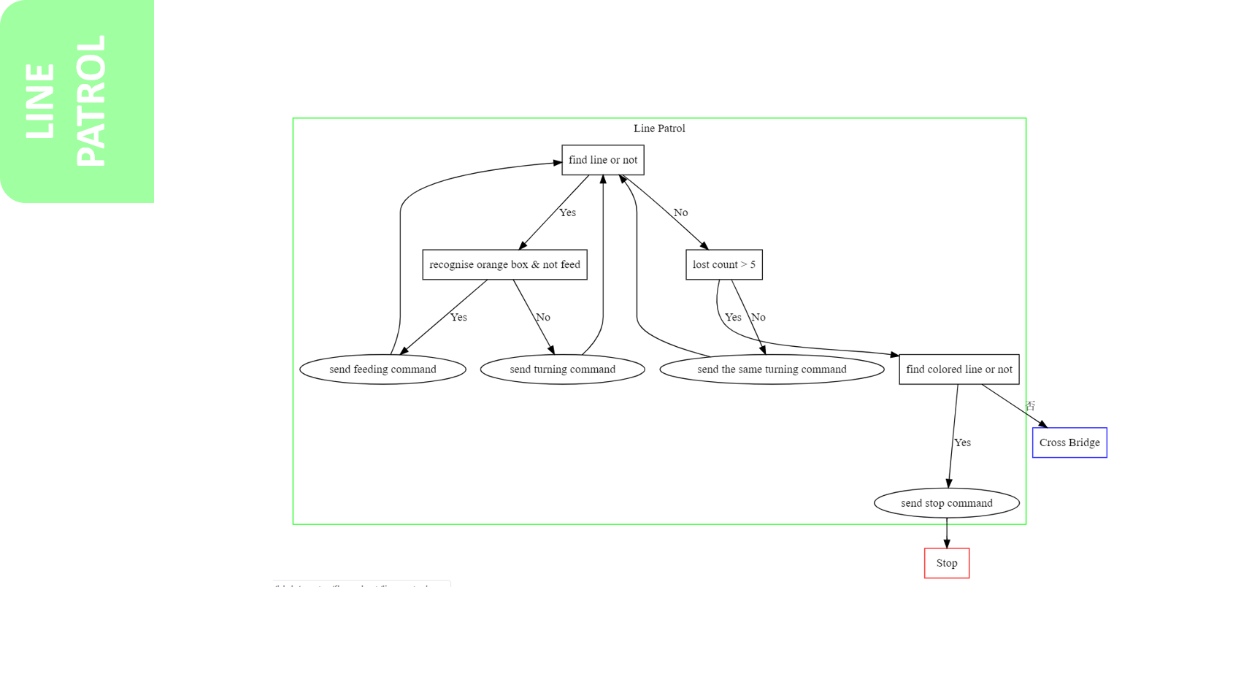
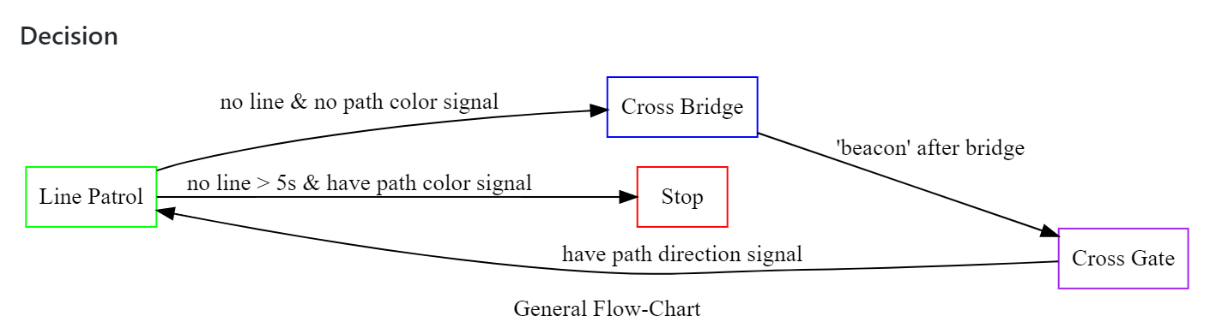
Refactor & Optimize
TOTAL DECISION DESIGN
Preliminary
Division of Work
Management
· Communicate with system architecture
· Flowchart code
· Python code
· Communicate with visual
Design
Environment
System
Decision
Visual
Chassis
Conclusion

Slide 24
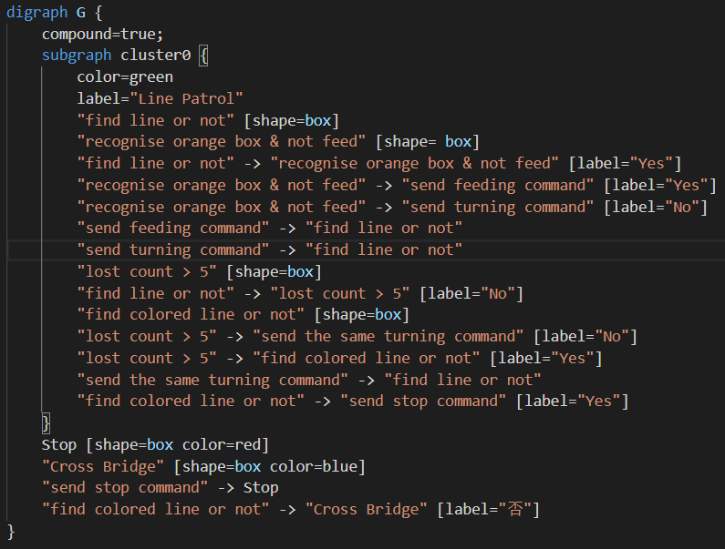
TOTAL DECISION DESIGN
· Communicate with system architecture
· Flowchart code
· Python code
· Communicate with visual
Preliminary
Division of Work
Management
Design
Environment
System
Decision
Visual
Chassis
Conclusion
graphviz

Slide 25

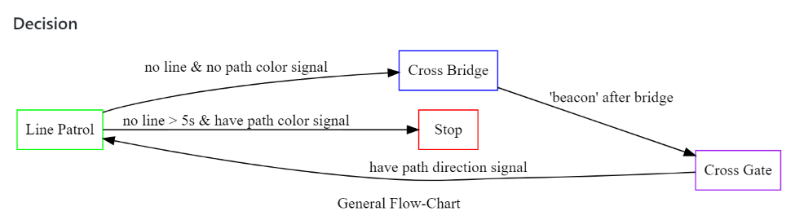
Preliminary
Division of Work
Management
Design
Environment
System
Decision
Visual
Chassis
Conclusion
graphviz

Slide 26
Preliminary
Division of Work
Management
Design
Environment
System
Decision
Visual
Chassis
Conclusion
graphviz

Slide 27
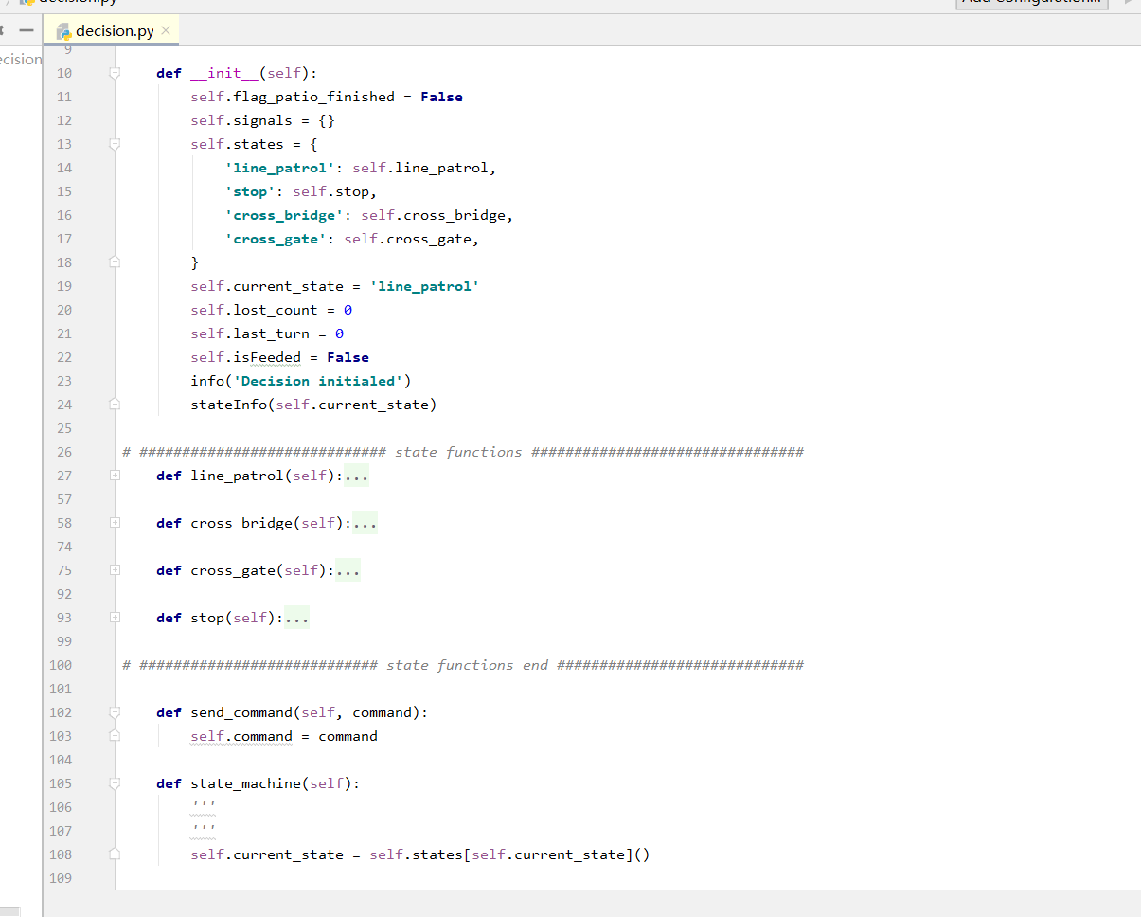
Preliminary
Division of Work
Management
Design
Environment
System
Decision
Visual
Chassis
Conclusion
graphviz

Slide 28
Preliminary
Division of Work
Management
Flow chart to Python code
· Determine the logic
· Make the flow chart
· Write decision part code
Design
Environment
System
Decision
Visual
Chassis
Conclusion
graphviz
MAIN CONTENT

Slide 29
Flow chart to Python code
· Determine the logic
· Make the flow chart
· Write decision part code
MAIN CONTENT
Preliminary
Division of Work
Management
· Beacon Detection & Color Filtering
Design
· Path Finding & Object Detection
· Sensor Selection & Implementation
Environment
System
Decision
Visual
Chassis
Conclusion
Obstacles
· RGB or HSV?
· How to remove noise of the ‘unsmooth’ Image?
Solution: LPF (Gaussian Blur) + Opening Operation (Eroding + Dilating)
· How to find the thresholds efficiently?

Slide 30
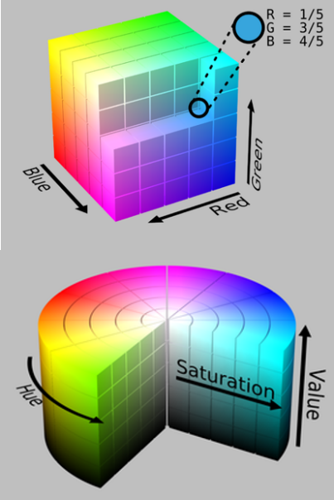
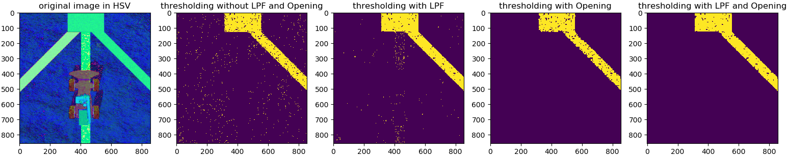
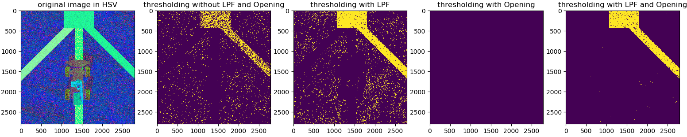
MAIN CONTENT
· Path Finding & Object Detection
· Sensor Selection & Implementation
· Beacon Detection & Color Filtering
Obstacles
Preliminary
Division of Work
Management
Design
· RGB or HSV?
· How to remove noise of the ‘unsmooth’ Image?
Solution: LPF (Gaussian Blur) + Opening Operation (Eroding + Dilating)
· How to find the thresholds efficiently?
Environment
System
Decision
Visual
Chassis
Conclusion

Slide 31
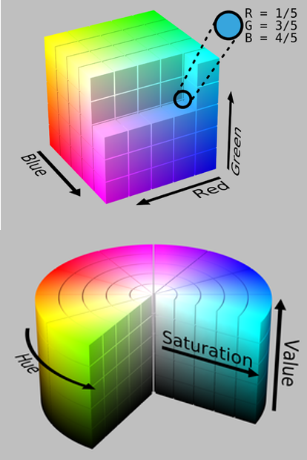
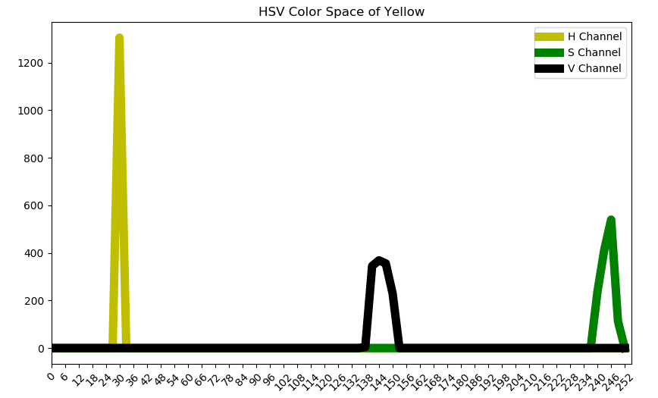
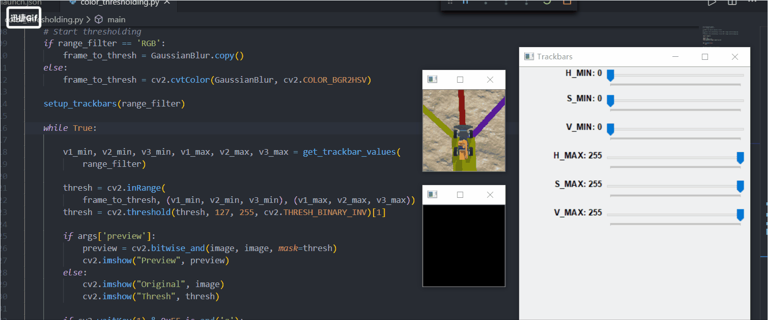
· Beacon Detection & Color Filtering
Obstacles
· RGB or HSV?
· How to remove noise of the ‘unsmooth’ Image?
Solution: LPF (Gaussian Blur) + Opening Operation (Eroding + Dilating)
· How to find the thresholds efficiently?
Preliminary
Division of Work
Management
Design
Environment
System
Decision
Visual
Chassis
Conclusion

Slide 32

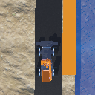
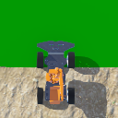
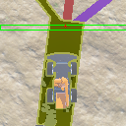
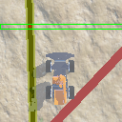
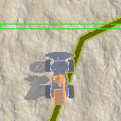
Obstacles
· RGB or HSV?
· How to remove noise of the ‘unsmooth’ Image?
Solution: LPF (Gaussian Blur) + Opening Operation (Eroding + Dilating)
· How to find the thresholds efficiently?
· Beacon Detection & Color Filtering
Preliminary
Division of Work
Management
Design
Environment
System
Decision
Visual
Chassis
Conclusion

Slide 33
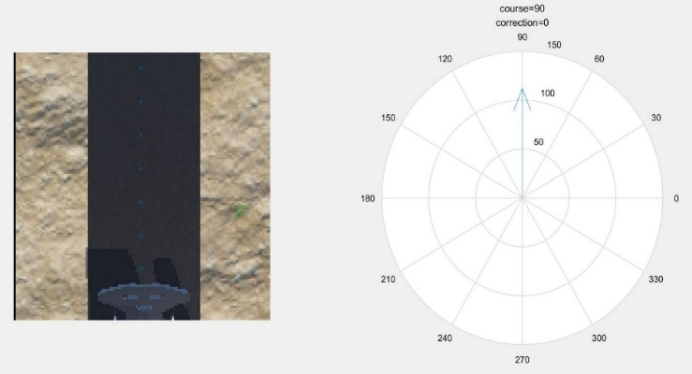
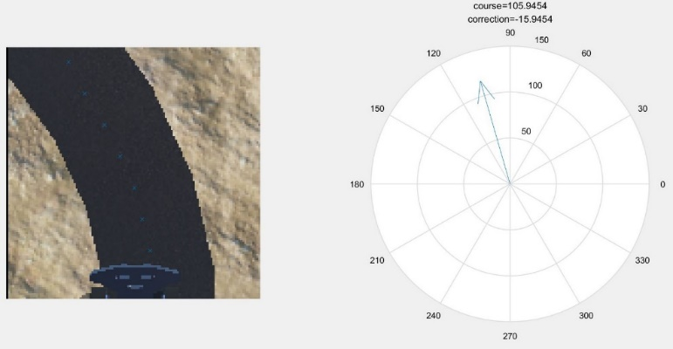
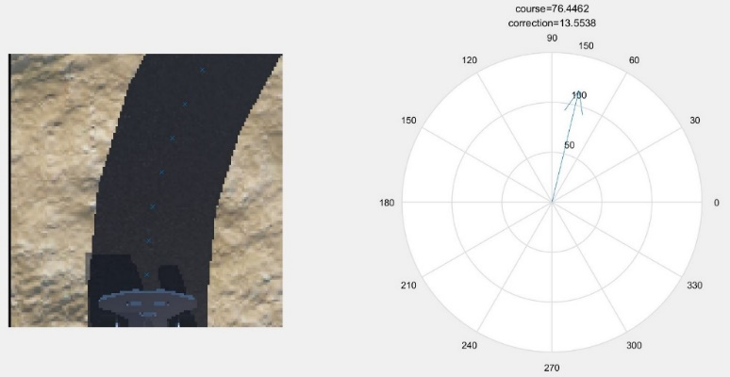
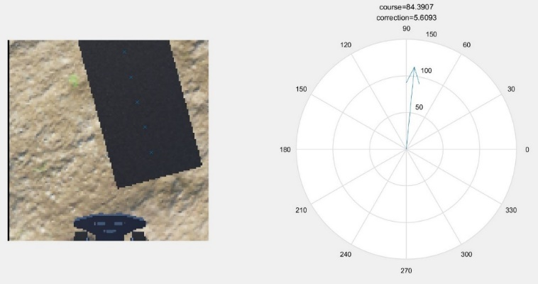



· Beacon Detection & Color Filtering
Preliminary
Division of Work
Management
Design
Environment
System
Decision
Visual
Chassis
Conclusion

Slide 34

· Beacon Detection & Color Filtering
· Path Finding & Object Detection
Preliminary
Division of Work
Management
Design
Environment
System
Decision
Visual
Chassis
Conclusion

Slide 35








· Path Finding & Object Detection
Preliminary
Division of Work
Management
Design
Environment
System
Decision
Visual
Chassis
Conclusion

Slide 36



· Path Finding & Object Detection
Preliminary
FASTER
Division of Work
Management
Design
Up to 3 times faster for certain task
Environment
System
Decision
Visual
Chassis
EASY CODING
Highly readable codes
Easy conversion between different languages
Better understanding of the code
Conclusion
HIGH PERTINENCY
High accuracy
Easy debugging and adjusting

Slide 37



· Path Finding & Object Detection
Preliminary
FASTER
Division of Work
Management
Design
Up to 3 times faster for certain task
Environment
System
Decision
Visual
Chassis
EASY CODING
Highly readable codes
Easy conversion between different languages
Better understanding of the code
Conclusion
HIGH PERTINENCY
High accuracy
Easy debugging and adjusting

Slide 38


· Sensor Selection & Implementation
Preliminary
· Get farmiliar with built-in Sensors
· Test possible solutions
· Delete unnecessary sensors
·Process raw data to signals
FASTER
Division of Work
Management
Design
Up to 3 times faster for certain task
Environment
System
Decision
Visual
Chassis
EASY CODING
Highly readable codes
Easy conversion between different languages
Better understanding of the code
Conclusion
HIGH PERTINENCY
High accuracy
Easy debugging and adjusting

Slide 39

· Sensor Selection & Implementation
· Get farmiliar with built-in Sensors
· Test possible solutions
· Delete unnecessary sensors
·Process raw data to signals
Final Plan
One camera towards down to detect the path..
One camera towards left to detect the bridge and gate..
One compass to detect the moving direction of the robot..
Preliminary
Division of Work
Management
Design
Environment
System
Decision
Visual
Chassis
Conclusion

Slide 40


· Sensor Selection & Implementation
Final Plan
One camera towards down to detect the path..
One camera towards left to detect the bridge and gate..
One compass to detect the moving direction of the robot..
· Get farmiliar with built-in Sensors
· Test possible solutions
· Delete unnecessary sensors
·Process raw data to signals
Preliminary
Division of Work
Management
Design
Environment
System
Decision
Visual
Chassis
Conclusion

Slide 41




Final Plan
One camera towards down to detect the path..
One camera towards left to detect the bridge and gate..
One compass to detect the moving direction of the robot..
· Sensor Selection & Implementation
· Chassis Modeling & Importing
Preliminary
Division of Work
Management
· Model simplification
· Center of wheels adjusting
· Material importing
Design
Environment
System
Decision
Visual
Chassis
Conclusion

Slide 42



· Chassis Modeling & Importing
· Feeder Arm Development
Preliminary
Division of Work
Management
Design
Environment
System
Decision
Visual
Chassis
Conclusion

Slide 43


· Feeder Arm Development
· Chassis Specifications
Preliminary
Division of Work
Management
Design
Environment
System
Decision
Visual
Chassis
Conclusion

Slide 44


· Chassis Specifications
· Center of Mass
· Center of mass infect its steering performance
· The center of mass in the chassis and the arm is different
· Mass of the car and wheel does matter on the sand ground
Preliminary
Division of Work
Management
Design
Environment
System
Decision
Visual
Chassis
Conclusion

Slide 45




· Center of mass infect its steering performance
· The center of mass in the chassis and the arm is different
· Mass of the car and wheel does matter on the sand ground
?
· Center of Mass
· Frame Loss & PID Control
Angle the chassis received
The car do not change so fast → the differential part make the performance worse
Preliminary
Division of Work
Management
Design
Environment
System
Decision
Visual
Chassis
some frame have lost
Conclusion
Add the limitation for command frequency

Slide 46
Mihotel
Thank You

Slide 47


Conclusion

